Slide 1
Crop Production Analysis in India

Slide 2
Introduction
The Agriculture business domain, as a vital part of the overall supply chain, is expected to highly evolve in the upcoming years via the developments, which are taking place on the side of the Future Internet. This paper presents a novel Business-to-Business collaboration platform from the agri-food sector perspective, which aims to facilitate the collaboration of numerous stakeholders belonging to associated business domains, in an effective and flexible manner.

Slide 3
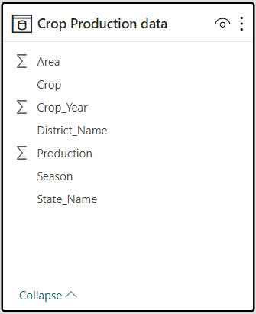
Details of data

Slide 4
Main Analysis
Production by State
Area of Production by State
Production by Season
Production by Year (1997 - 2015)

Slide 5
Mock – up Dashboard
Crop Production Analysis in India
Page 1
Page 2

Slide 6
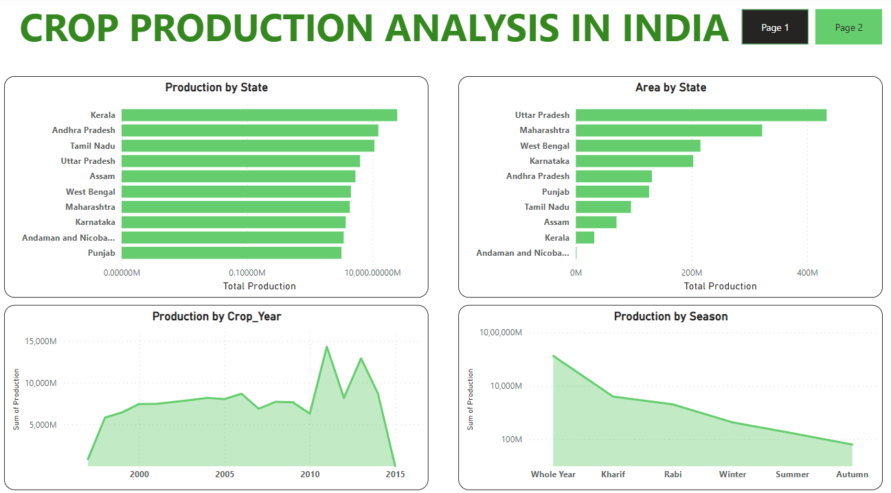
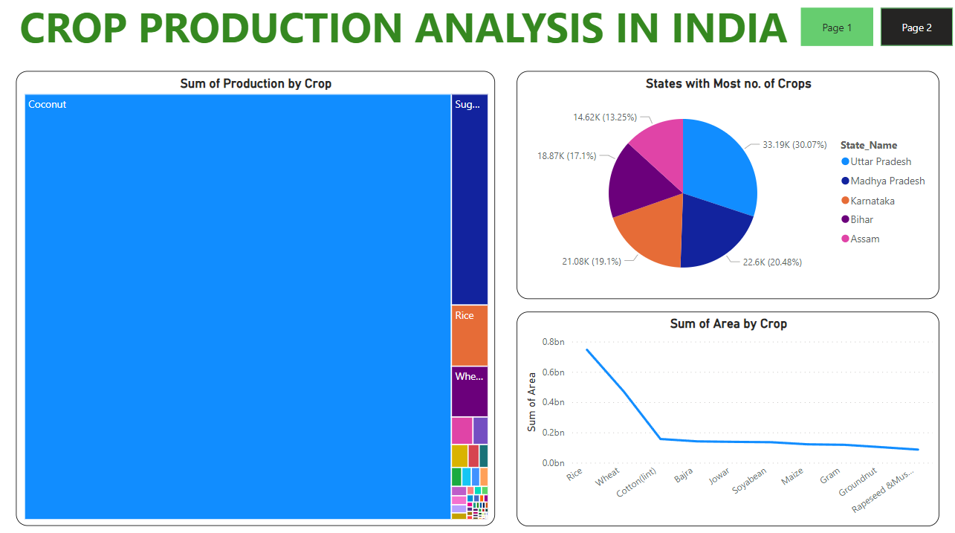
My Design

Slide 7
Thank You

